Slide 1



Atmospheric Particulate Analysis near Mining Operations in Southern Arizona
Presenter: Kyle Rine
Acknowledgements: A.E. Sáez, E.A.Betterton, J. Csavina, A. Wonaschutz, W. Conant, B. Barbaris, A. Landázuri, P. Rheinheimer, A. Campillo
Research Supported by NIEHS Superfund Research Program
2010 Arizona Space Grant Consortium Symposium.

Slide 2
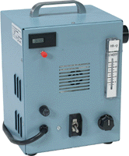
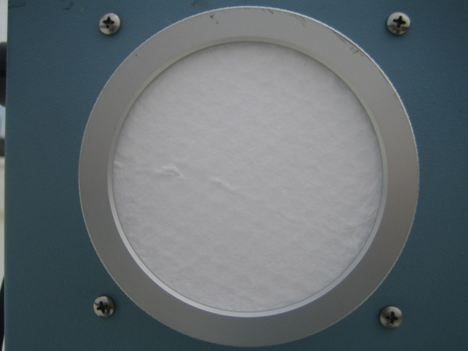
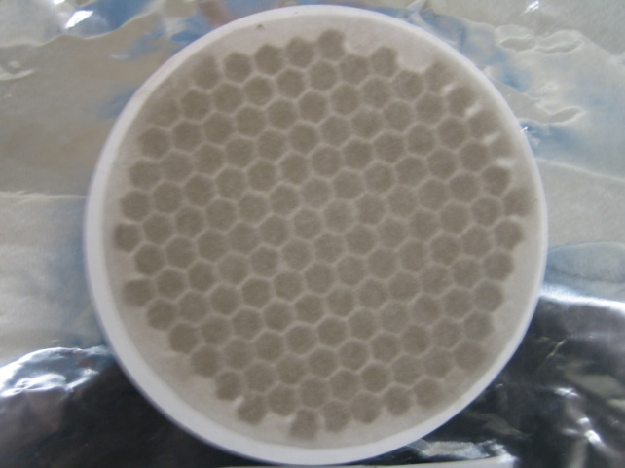
Total Suspended Particulate
Sampling with the Hi-Q High Volume Portable Air Sampler
Sampling Rate: 12 - 15 cfm
Uses 4 inch borosilicate glass fiber filters
Samples ran for 24 consecutive hours
TSP Sampler
Clean and Dirty Filters

Slide 3
Analysis
All samples are analyzed for heavy metals and water soluble Ion content.
Ion Chromatography
Samples are analyzed for water soluble ions.
Prominent ions detected: Calcium, Potassium,
Magnesium, Sodium, Ammonium, Chloride, Acetate,
Formate, Nitrate, Sulfate
Inductively Coupled Plasma Mass Spectroscopy
Resolves metals and metaloids concentrations within the
samples.

Slide 4
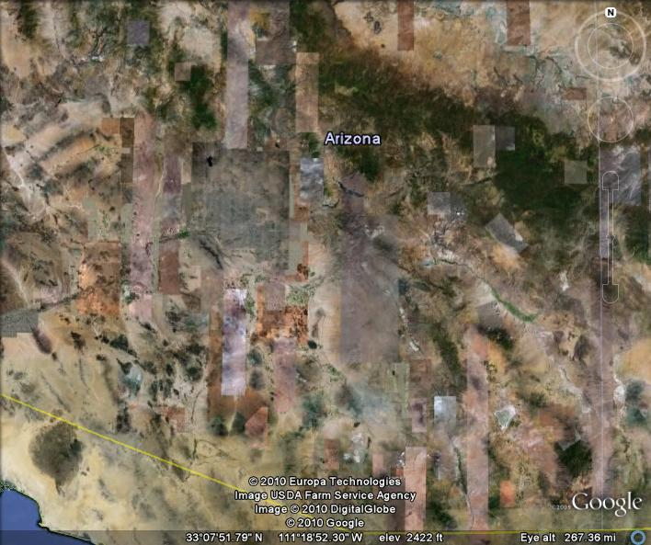
Dewey-Humbolt
Sampling Sites
Hayden
Mt Lemmon
Tucson
Willcox
Green Valley

Slide 5
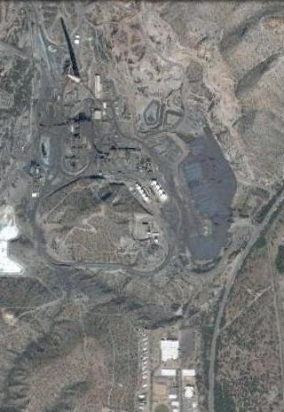
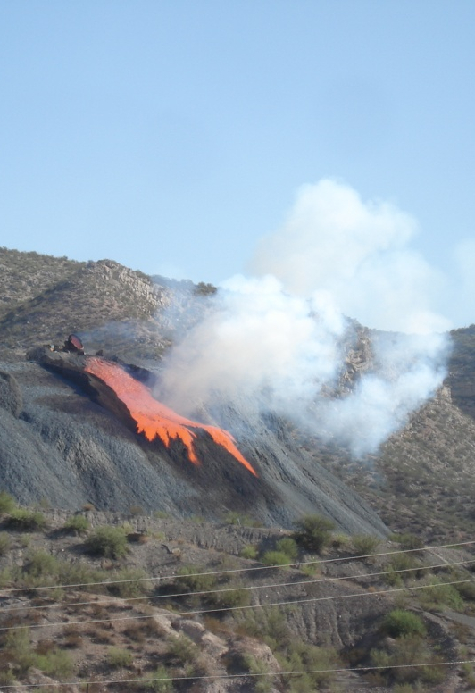
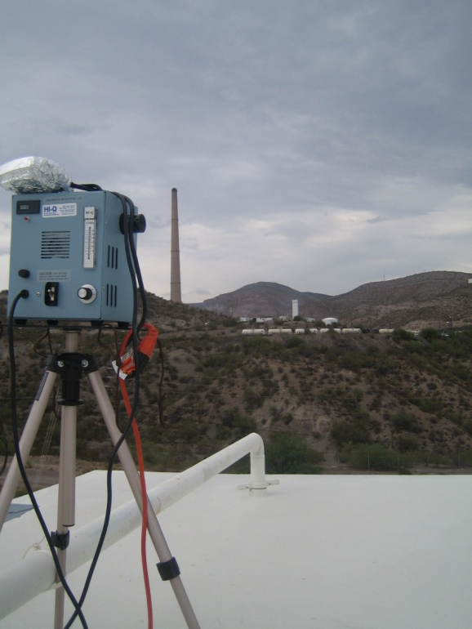
Hayden, AZ
The ASARCO Smelter is less than two miles from
Hayden High School, our sampling site.
Active smelter and active mine.
Large tailings pile within one mile of sampling site.
ASARCO Smelter
Hayden HS
Sampling Site

Slide 6
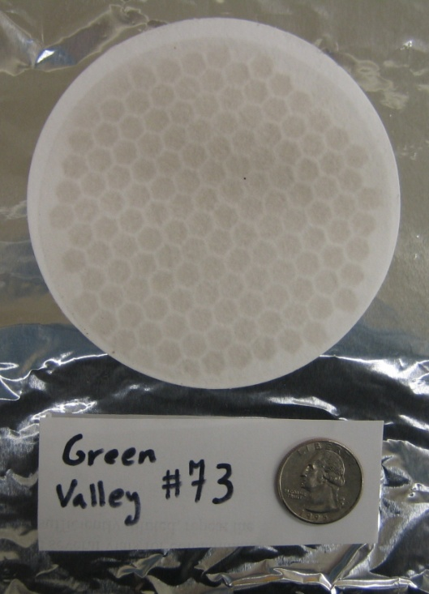
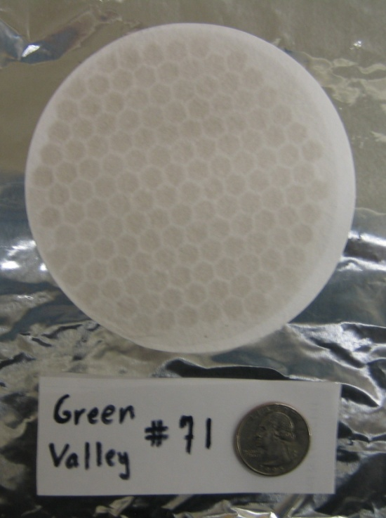
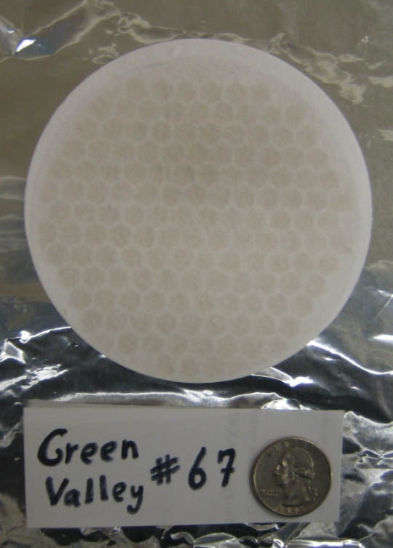
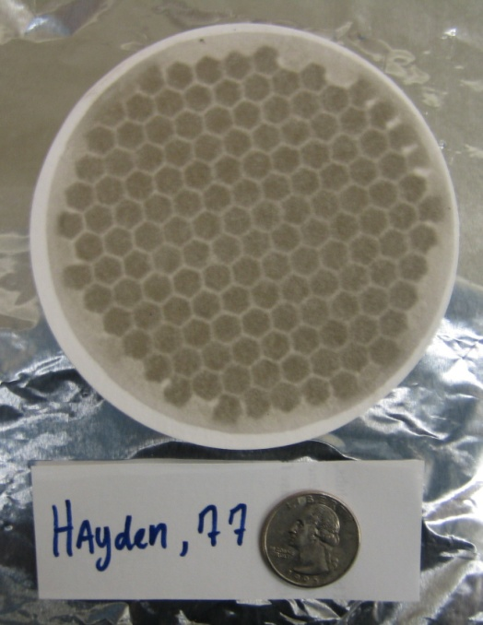
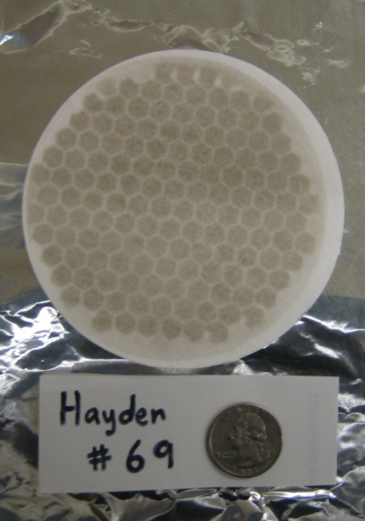
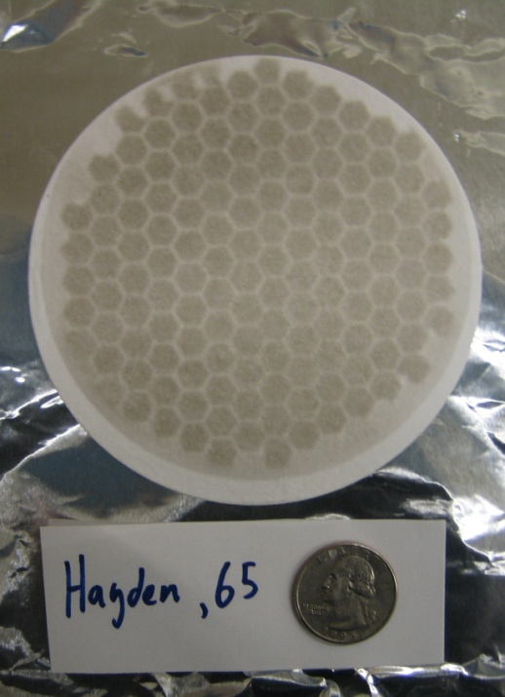

Slide 7
Hayden and Wilcox 9/28/2009
Air Concentration ng/m^3

Slide 8
Hayden and Wilcox 9/14/2009
Air Concentration ng/m^3

Slide 9
Average Metals Concentrations

Slide 10
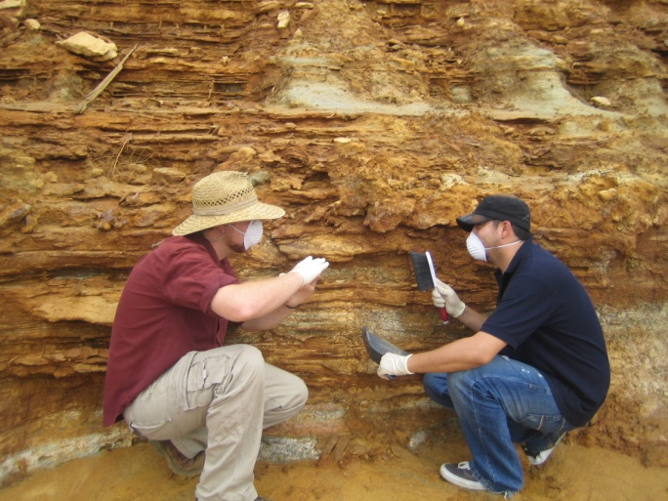
Conclusions and Future Work
High levels of airborne contaminates present at the site clearly indicate health risks to local populations and surrounding ecology.
Further sampling at site and investigation into contaminations sources is currently underway.
As part of the EPA Superfund fund program, information gathered at the site will be of significant importance in determining cleanup procedures and preventative measures implemented at the site.

Slide 11
Thank You

